Slide 1

Indian Institute of Technology Guwahati Department of Civil Engineering SUBMITED BY- MANISH BHAGAT ROLL NO – 234104617 SUBMITED TO – Dr. Subasih Dutta (Professor Water resource Engineering and Management)

Slide 2
RESEARCH TOPIC-
Dam safety monitoring by Satellite Interferometric Synthetic Aperture InSAR remote sensing.

Slide 3
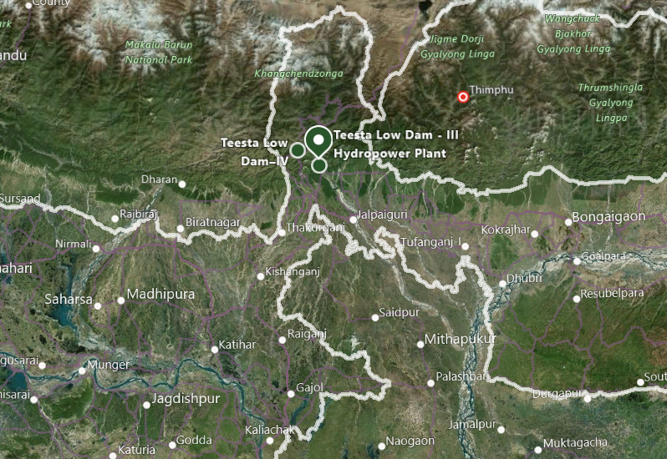
STUDY AREA
Reference- Google Image

Slide 4
DAMS IN TEESTA
Project/Dam Name | Output | Dam Location | Powerhouse Location
Teesta -V Dam | 510MW | Dikchu, Gangtok district, Sikkim | Balutar, Singtam, Gangtok district, Sikkim
Teesta III Dam | 1200MW | Chungthang, Mangan district, Sikkim | Singhik, Mangan district, Sikkim
Teesta Low Dam III | 132MW | Rambi Bazar, Kalimpong district, West Bengal | Rambi Bazar, Kalimpong district, West Bengal
Teesta Low Dam IV | 160MW | Kalijhora, Kalimpong district, West Bengal | Kalijhora, Kalimpong district, West Bengal
Teesta Barrage | N/A | Gajoldoba, Jalpaiguri district, West Bengal | N/A
Barakhata Teesta Barrage | N/A | Goddimari, Barakhata, Nilphamari District, Bangladesh | N/A
Teesta VI Dam | 500MW | Sirwani, Singtam, Gangtok district, Sikkim | Pamphok, Namchi district, Sikkim
Rangit III Dam | 60MW | Legship, Gyalshing district, Sikkim | N/A
Gati Hydropower Project | 110MW | Between the town of Rorathang and Rongli, Pakyong District, Sikkim | N/A
Dikchu River Hydroelectric Power Project | 96MW | Dikchu, Gangtok district, Sikkim | N/A
Madhya Bharat Power Corporation Limited | 96MW | Ranikhola, Gangtok district, Sikkim | Kumrek, Pakyong district, Sikkim

Slide 5
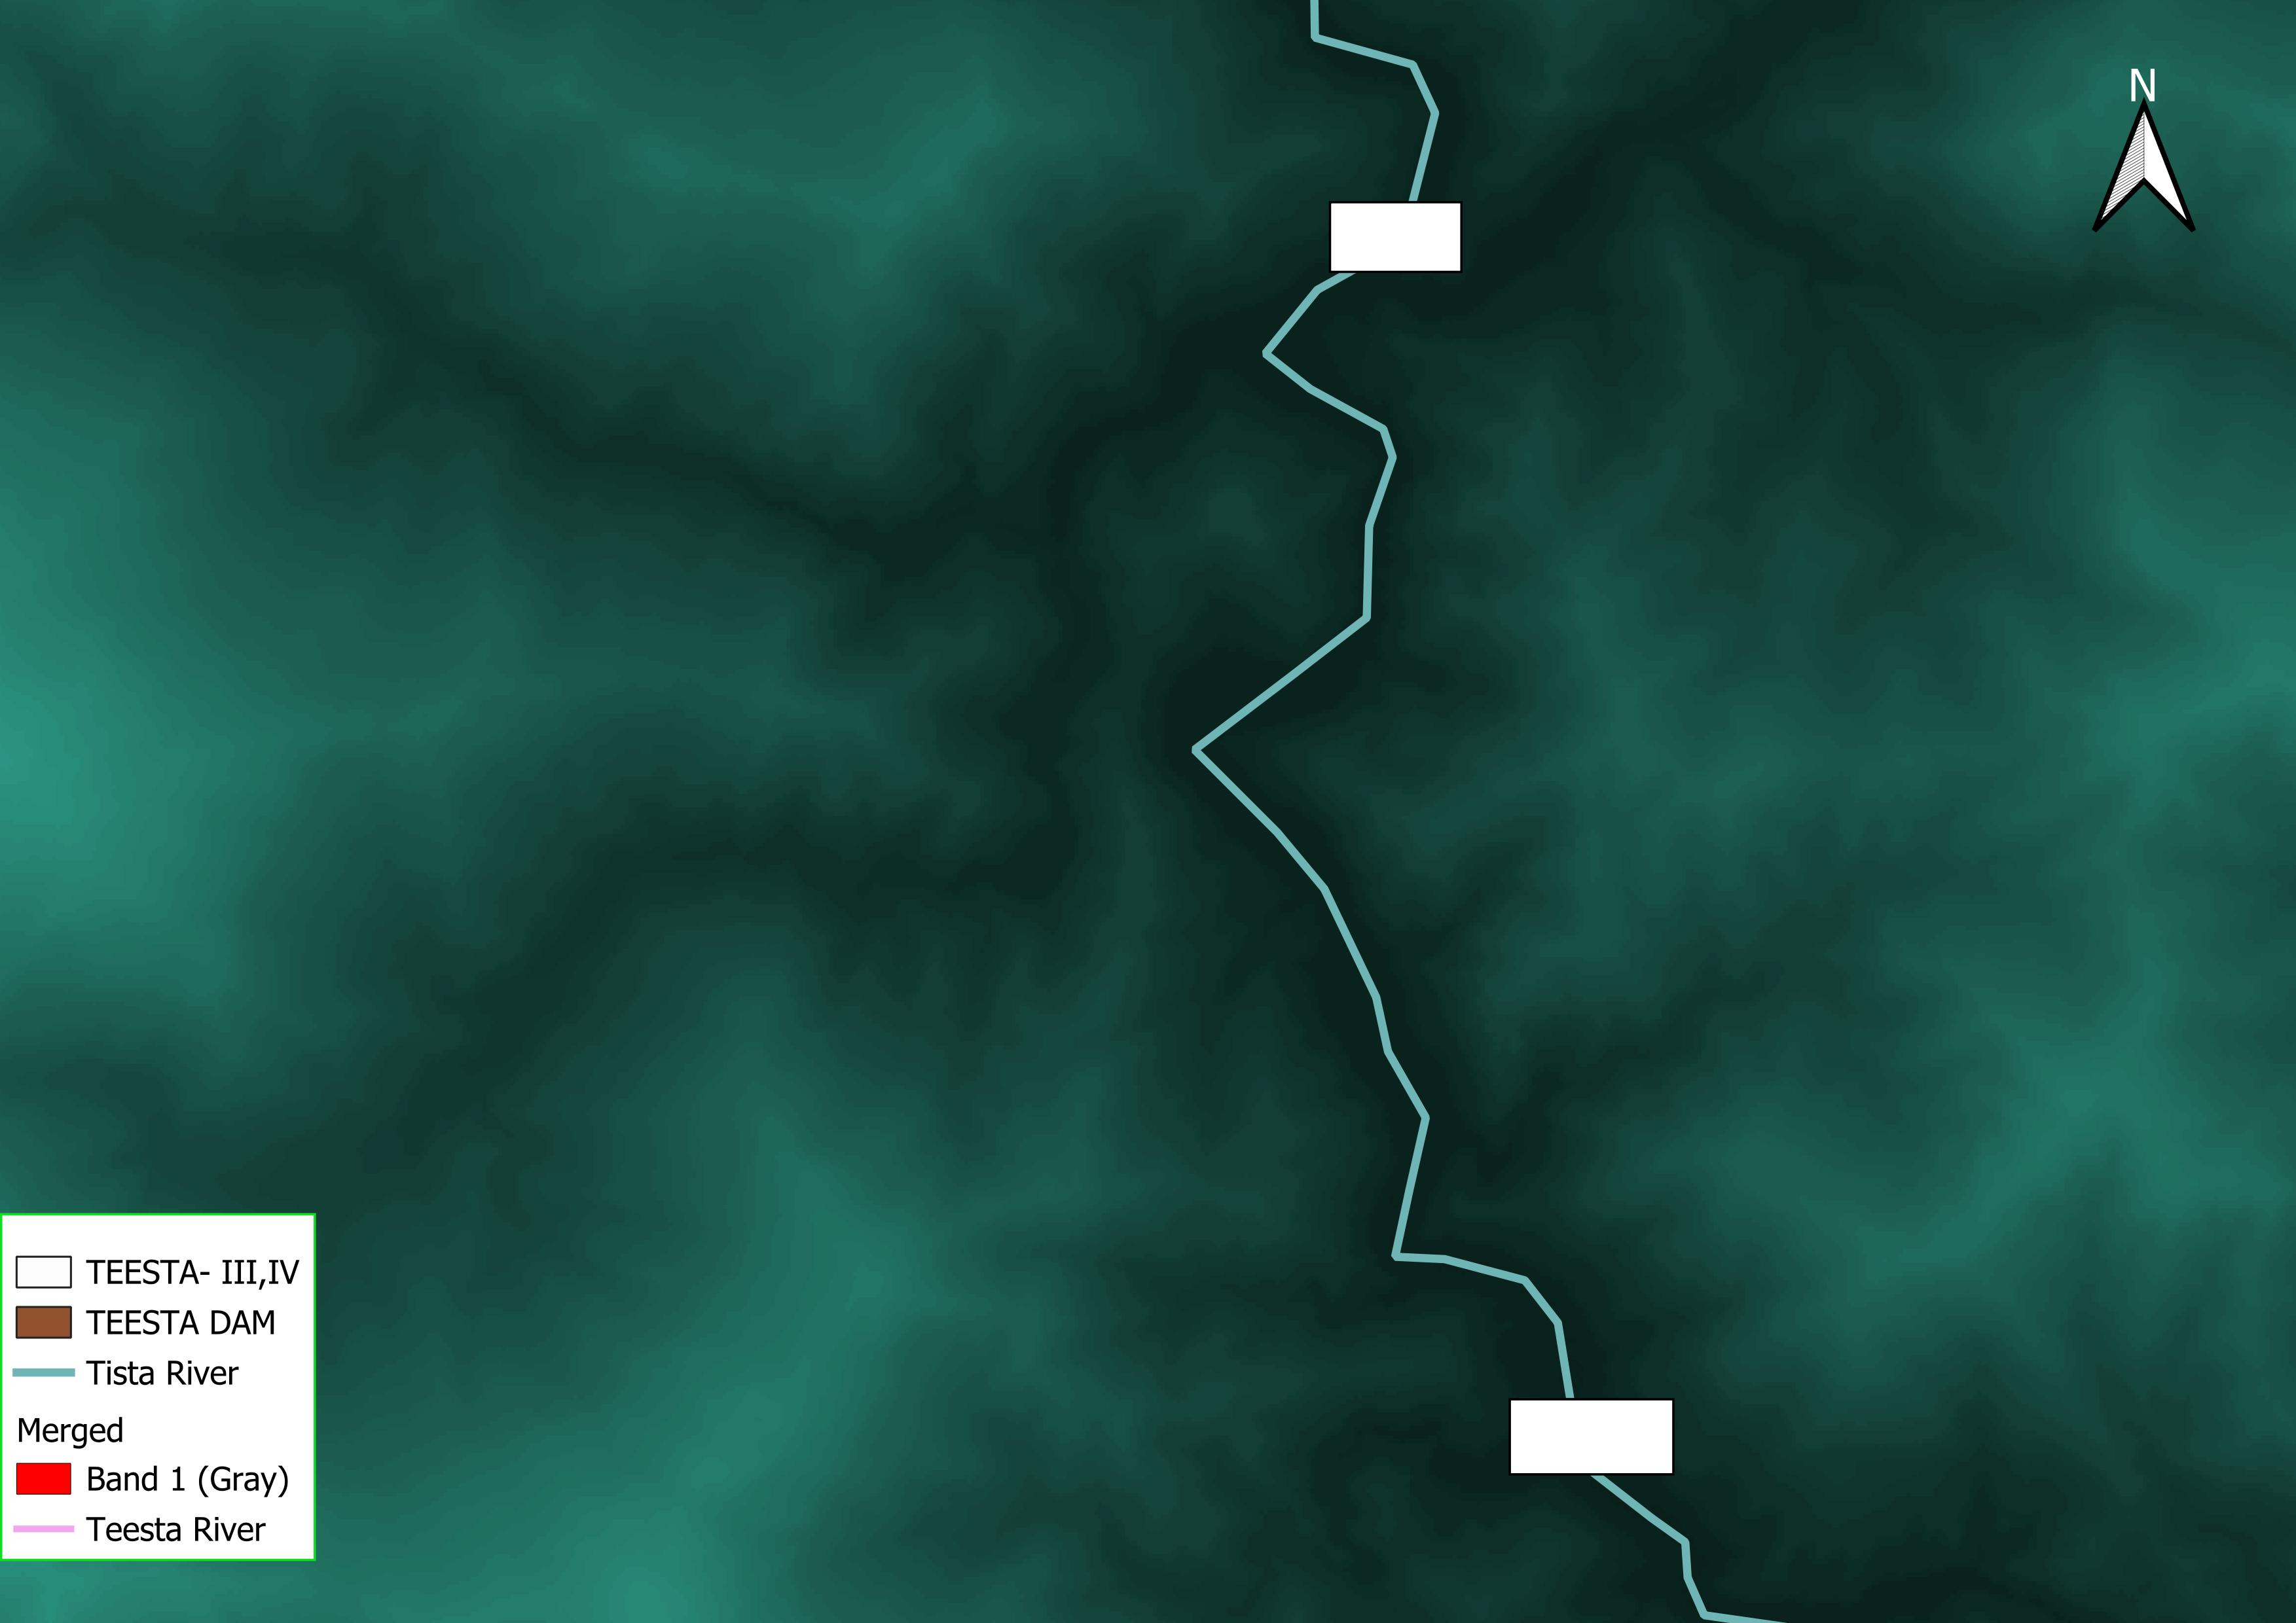
DAMS IN TEESTA
Reference- USGS,QGIS

Slide 6
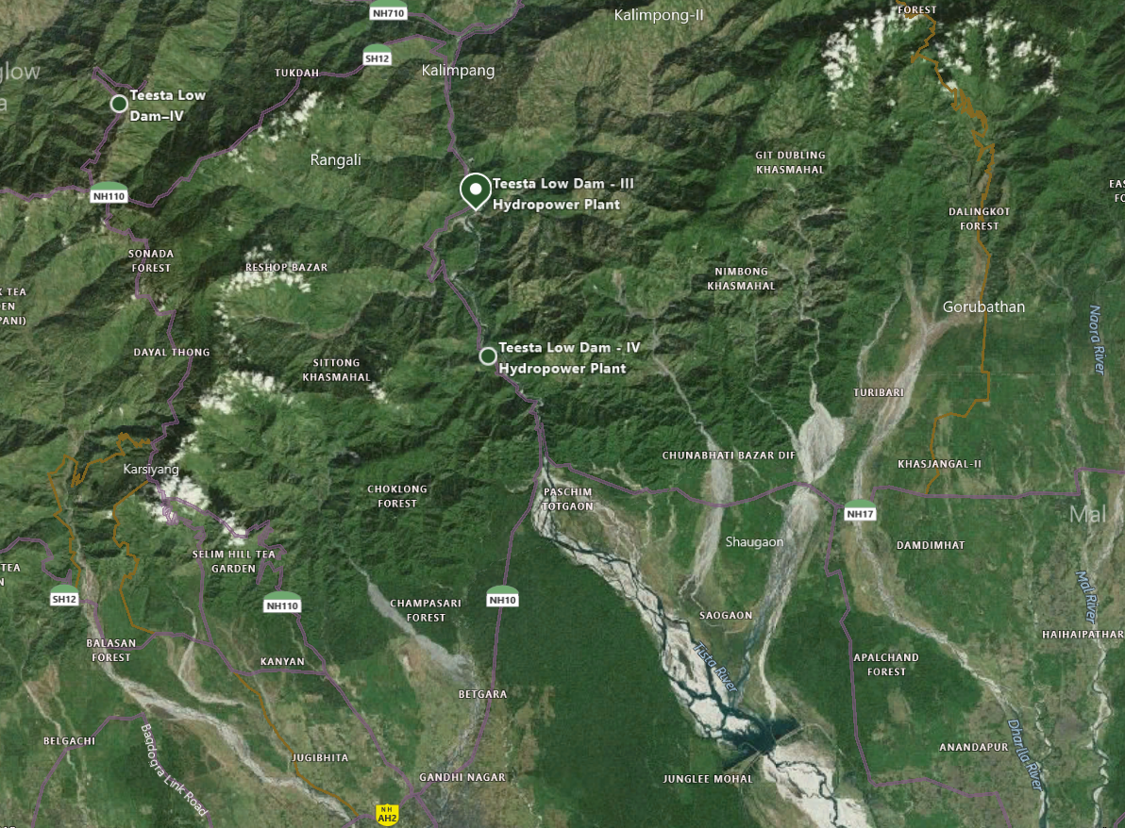
TEESTA LOW DAM-III, IV
Reference- Google Image
Reference- Google Image

Slide 7
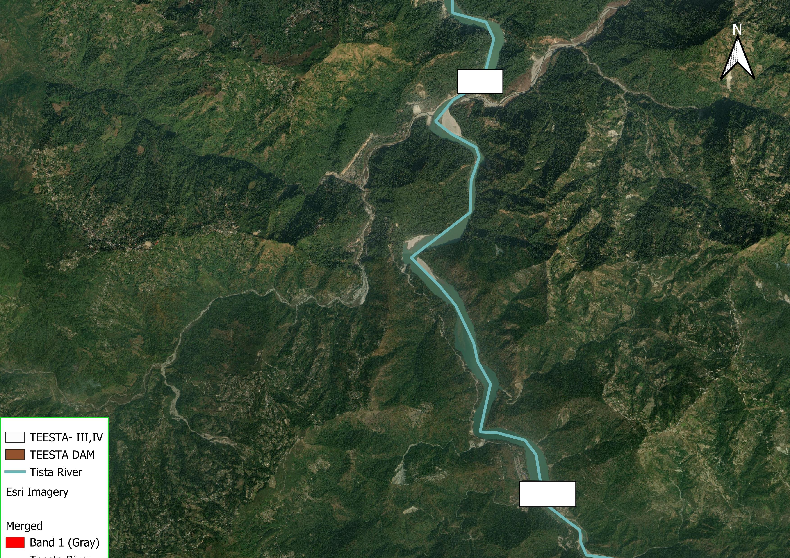
TEESTA LOW DAM-III, IV
Reference- QGIS

Slide 8
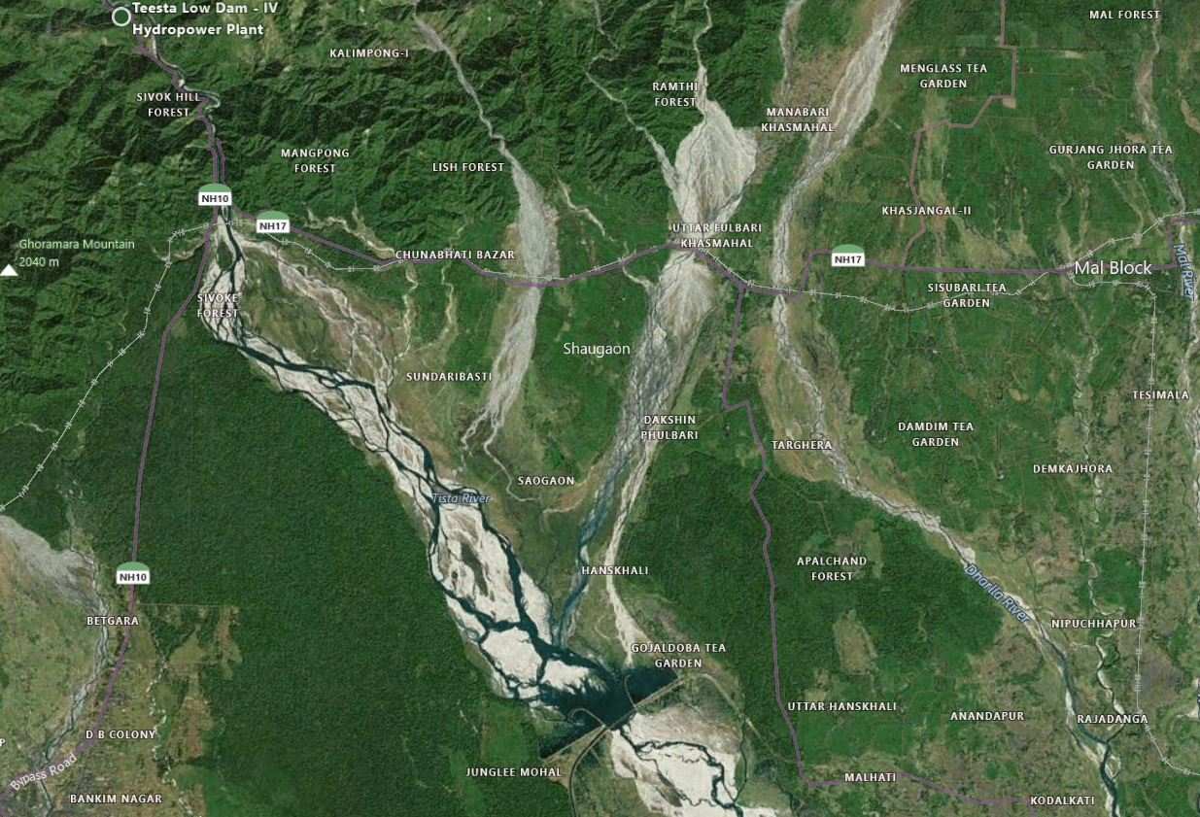
TEESTA RESERVOIR
Reference- Google Image

Slide 9
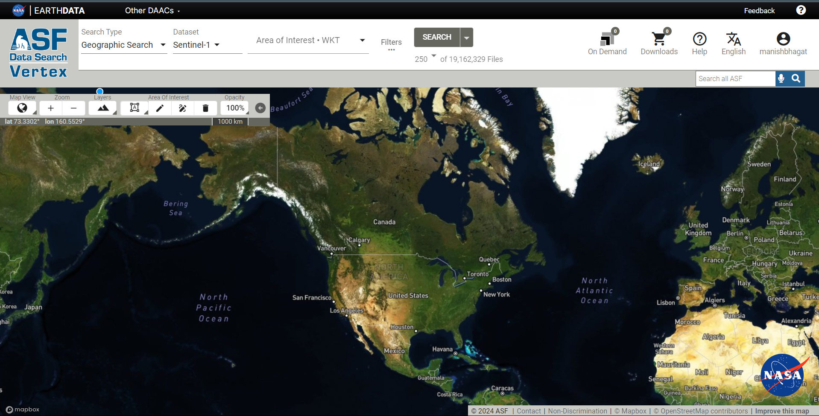

SOURCE FOR SENTINEL DATASET
NASA EARTH DATA (https://urs.earthdata.nasa.gov/users/new)
Alaska Satellite Facility (https://www.asf.alaska.edu)
SNAP (DEM Generation using Sentinel-1 images in SNAP)

Slide 10
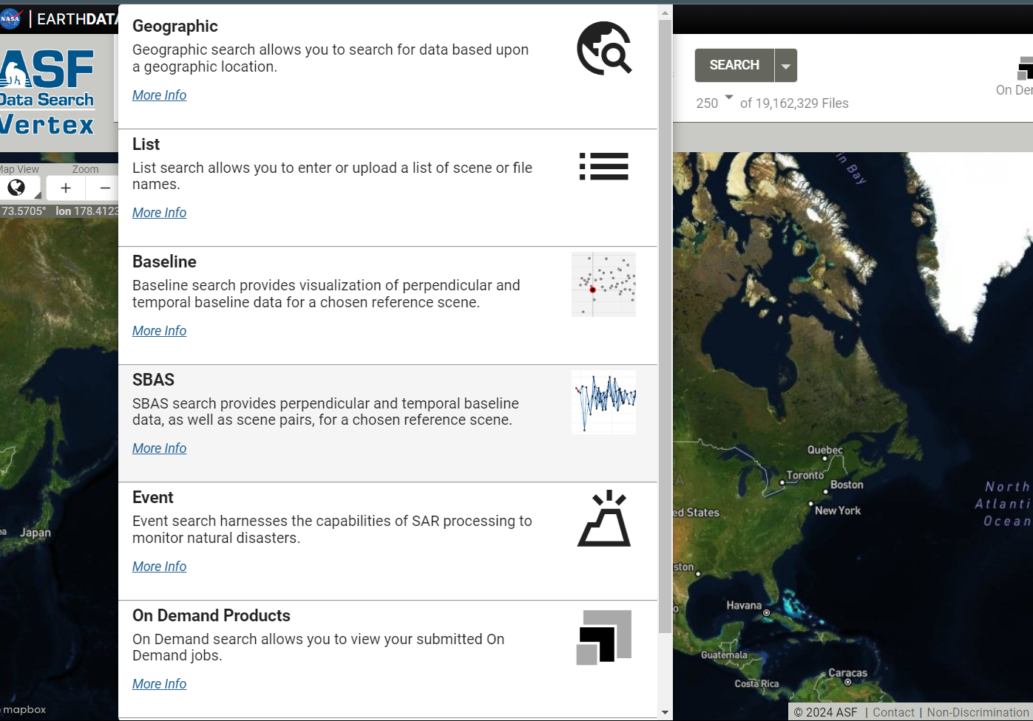
SOURCE FOR SENTINEL DATASET

Slide 11
SAR Resources
● Introduction to SAR Data https://earthdata.adobeconnect.com/p21n0thk15bz/
● Applications of SAR Data in GIS Environments https://earthdata.adobeconnect.com/potfhk9heoyk/
● Sentinel-1 On-Demand RTC Processing https://earthdata.adobeconnect.com/pjddg6rvg2g2/ EdX Alaska - Free! (Verified Certificate for $199 USD)
● Synthetic Aperture Radar: Hazards https://www.edx.org/course/sar-hazards Next session starts September 7, 2021 The SAR Handbook Comprehensive Methodologies for Forest Monitoring and Biomass Estimation DOI: 10.25966/nr2c-s697 Published April, 2019 Open Access! Polarimetric Synthetic Aperture Radar Principles and Application Domains: Forest, agriculture, cryosphere, urban and oceans DOI: 10.1007/978-3-030-56504-6 Published March 21, 2021

